Slide 1



Customer
Satisfaction Analysis
CustomerPulse Brazil (Data Analytics Team)

Slide 2


Problem Statement
Between 2017 and 2018, Olist in Brazil maintained an overall average review score within the satisfied range; however, 11.4% of customers were still highly unsatisfied. This raises the need to understand what drove these negative experiences and identify the steps required to address them.

Slide 3

Approches
Measure satisfaction levels
Evaluate product category performance
Examine delivery performance
Assess seller behavior

Slide 4

Satisfaction Level

Slide 5
Customer Satisfaction Overview
Years Filtered: Only 2017 and 2018
Total Revies Analyzed: ~ 98k
Highly Satisfied Customers: 57.81%
Highly Unsatisfied Customers: 11.46%
Average Review Score: 4.08 out of 5

Slide 6
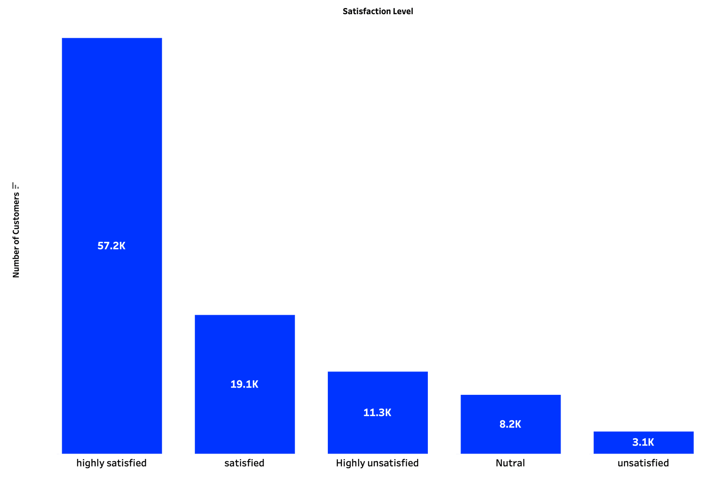
Customer Satisfaction Distribution

Slide 7
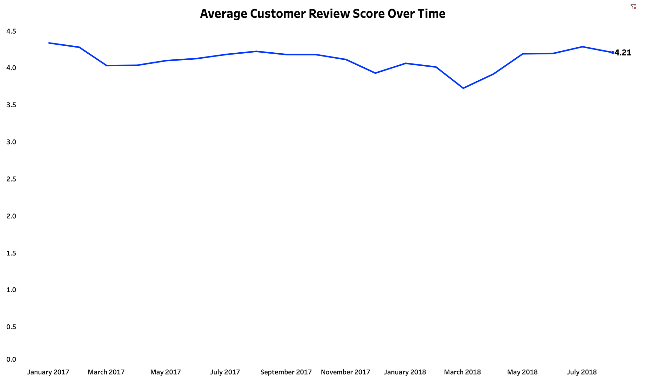
Average Customer Review Score Over Time

Slide 8

Category Performance

Slide 9
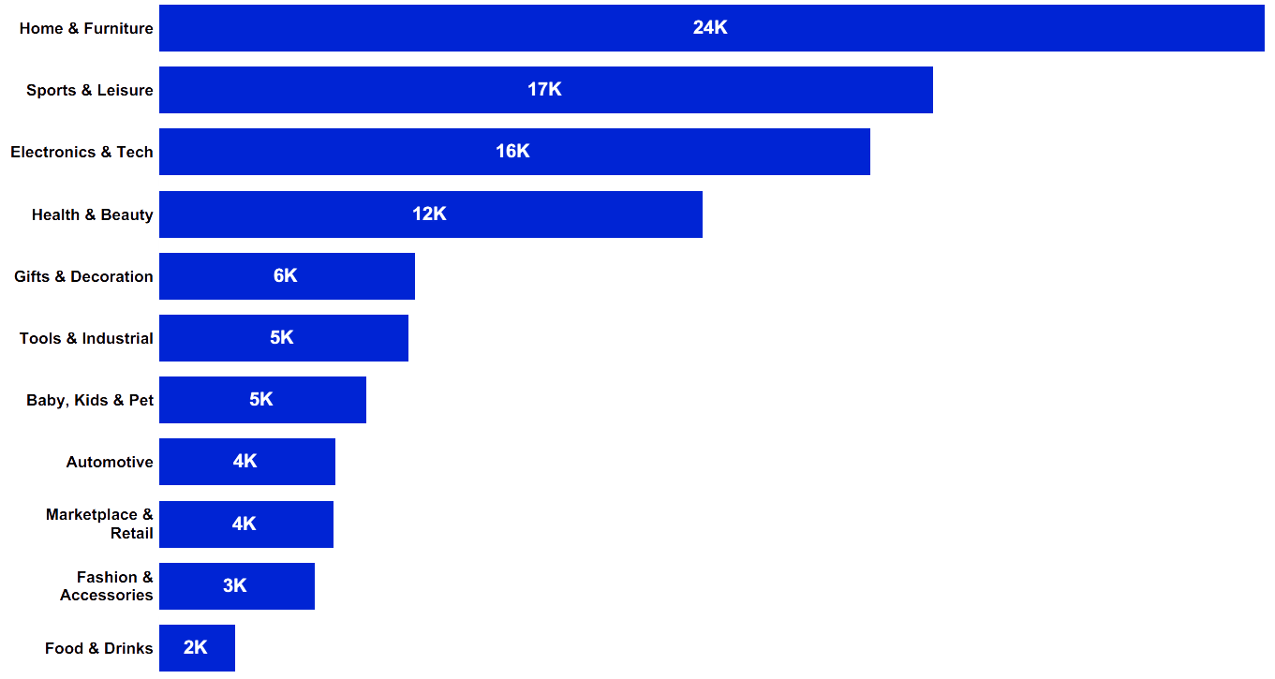
Total Reviews Per Category

Slide 10
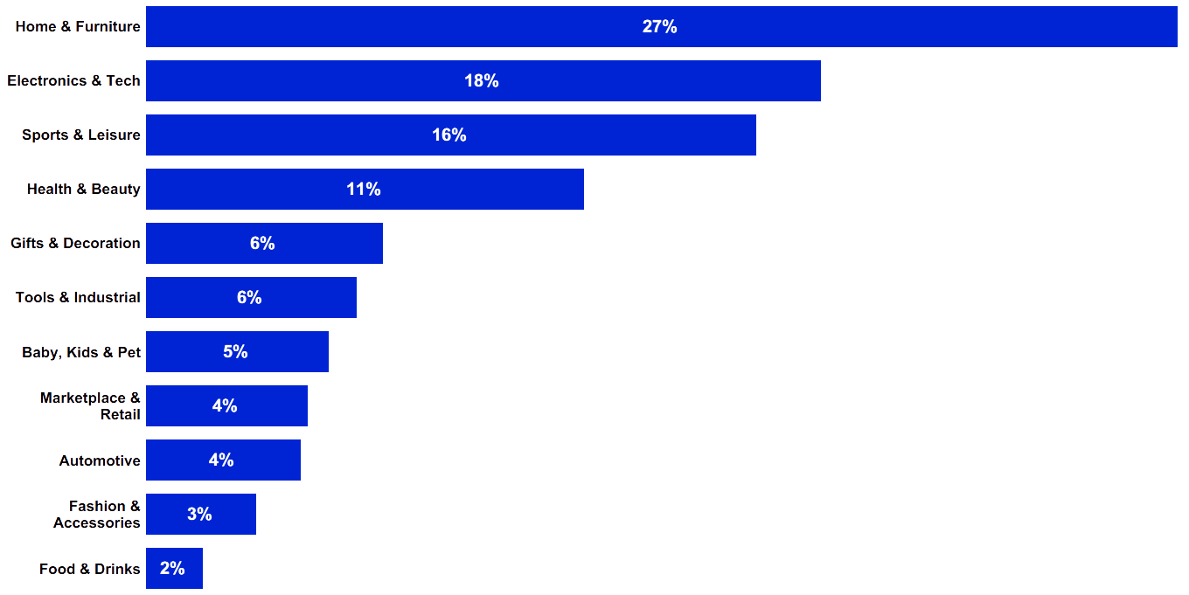
% Highly Unsatisfied Per Category

Slide 11
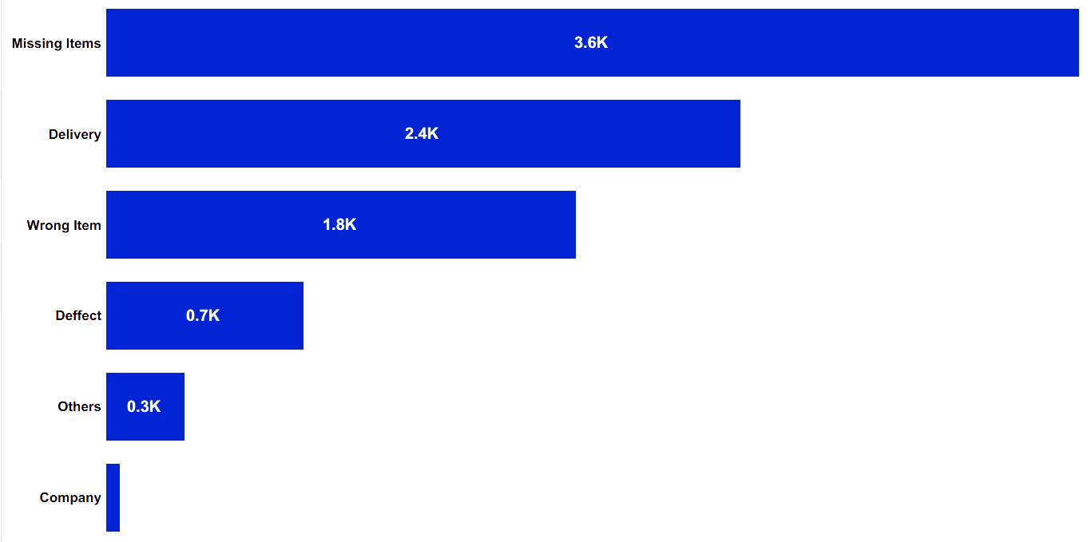
Highly Unsatisfied Comments Classification
Platform
Carrier
Seller

Slide 12
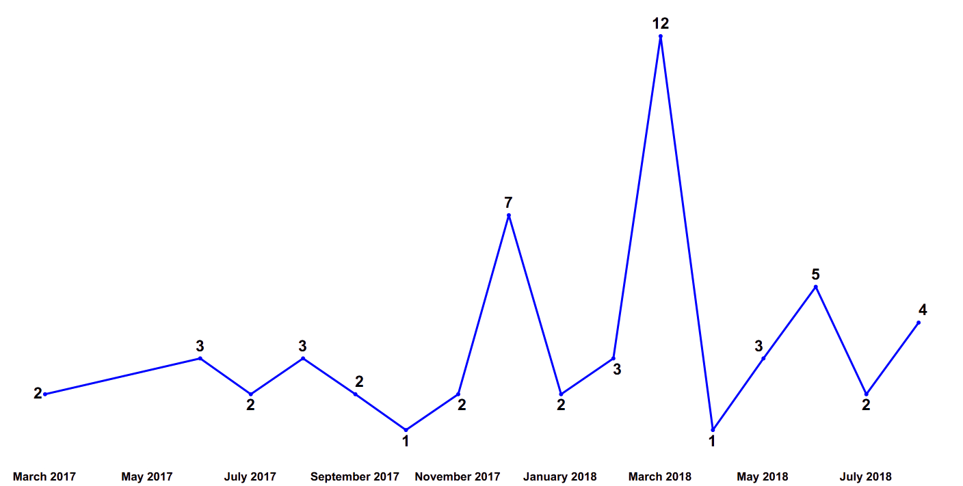
Platform Related Comments Over Time
Platform
Carrier
Seller

Slide 13
They advertised the product on the website, after it was purchased and payment approved, they canceled it because it was not in stock!!!
I contacted them several times by phone and they didn't answer, they hung up on me, the estimated deadline passed ......
I bought it wrong and got screwed! Excellent site for purchase but after-sales accessory services, exchange guidance, regret do not work!
The size is small and I realized later that the ad does not highlight the dimensions of the product. Leaves something to be desired.
Fake watch, I marvel at a big store like the lannister allow third parties to sell fake products.
Platform
Carrier
Seller

Slide 14



Recommendations
Strengthen After-Sales Support
Improve Product Information Accuracy
‘Update Refund and Return Policies

Slide 15

Carrier Performance

Slide 16
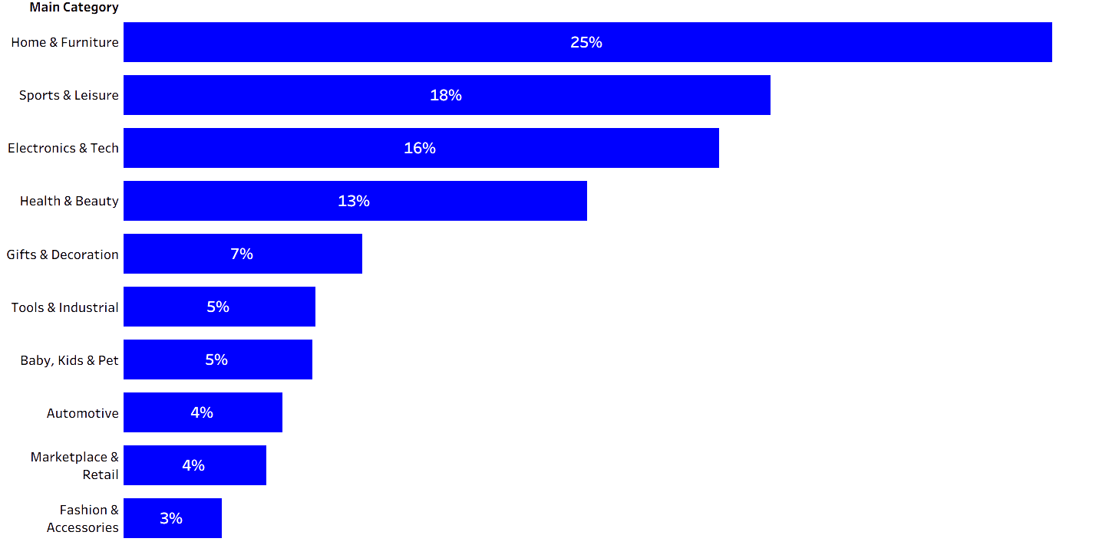
most late delivered category
Platform
Carrier
Seller

Slide 17
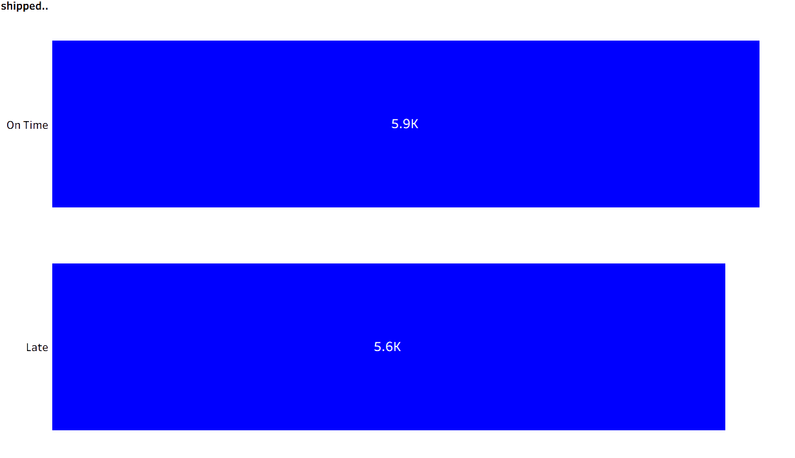
Highly unsatisfaction delivery spam
Platform
Carrier
Seller

Slide 18
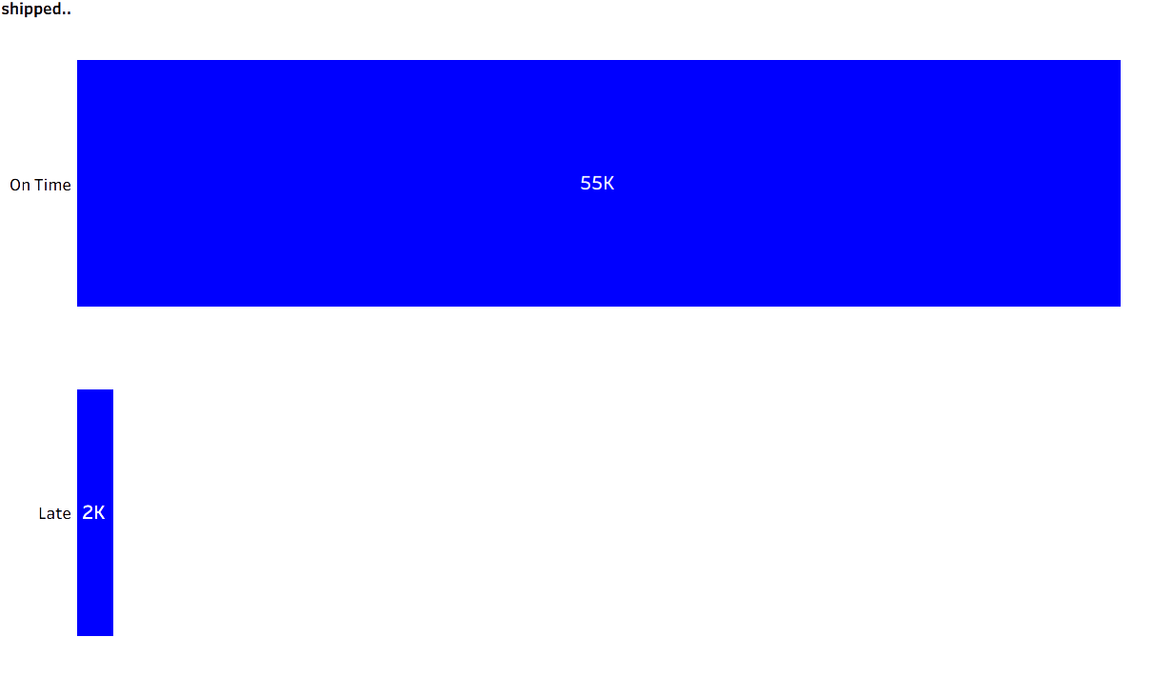
Highly satisfaction delivery spam
Platform
Carrier
Seller

Slide 19
Recommendations
Improve shipping and delivery processes
Partner with more reliable delivery companies.
Monitor supplier performance

Slide 20

Seller Performance

Slide 21
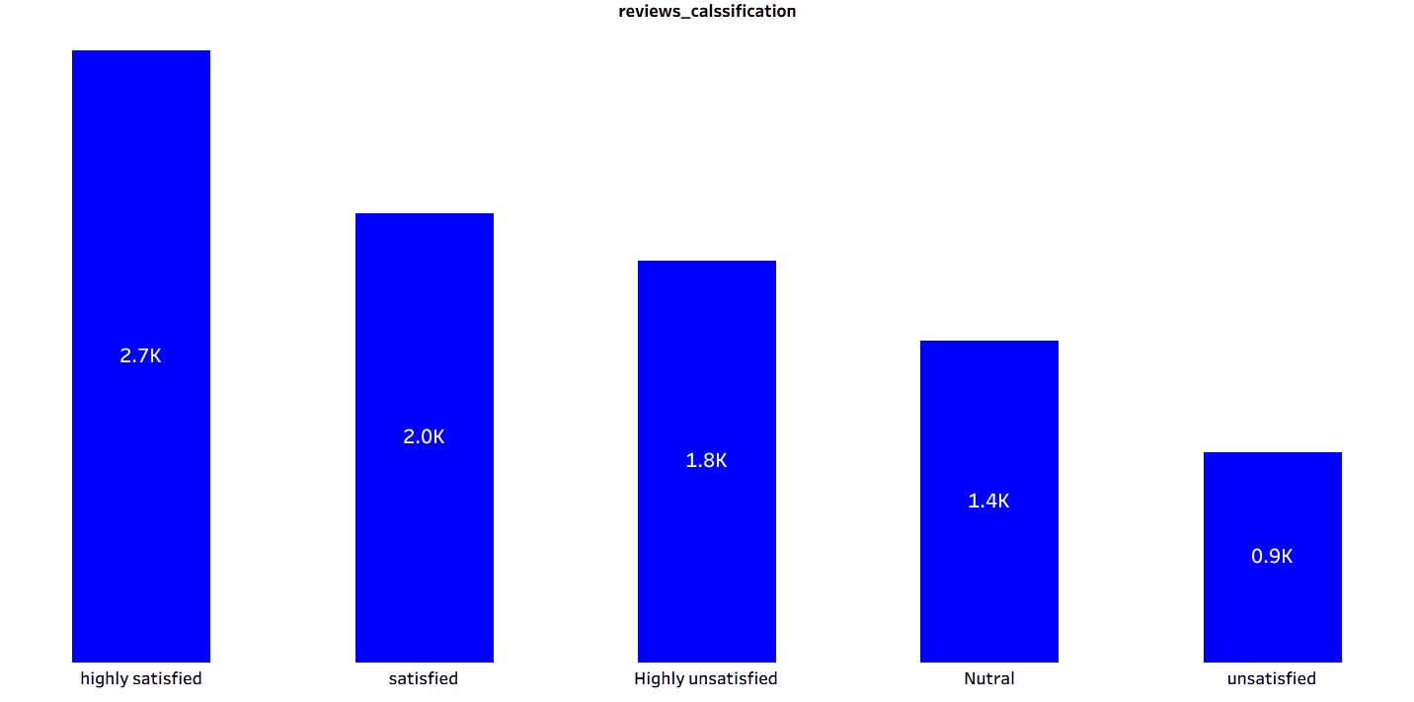
Total Sellers Per Review Score
Platform
Carrier
Seller

Slide 22
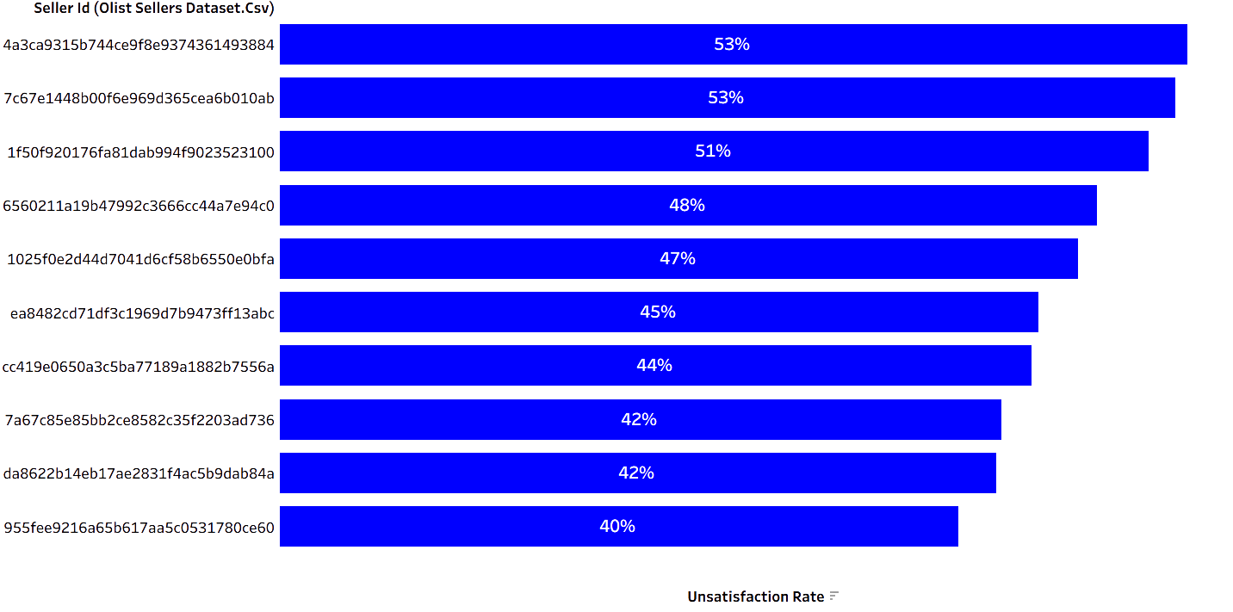
Top 10 Low Performing Sellers
Platform
Carrier
Seller

Slide 23
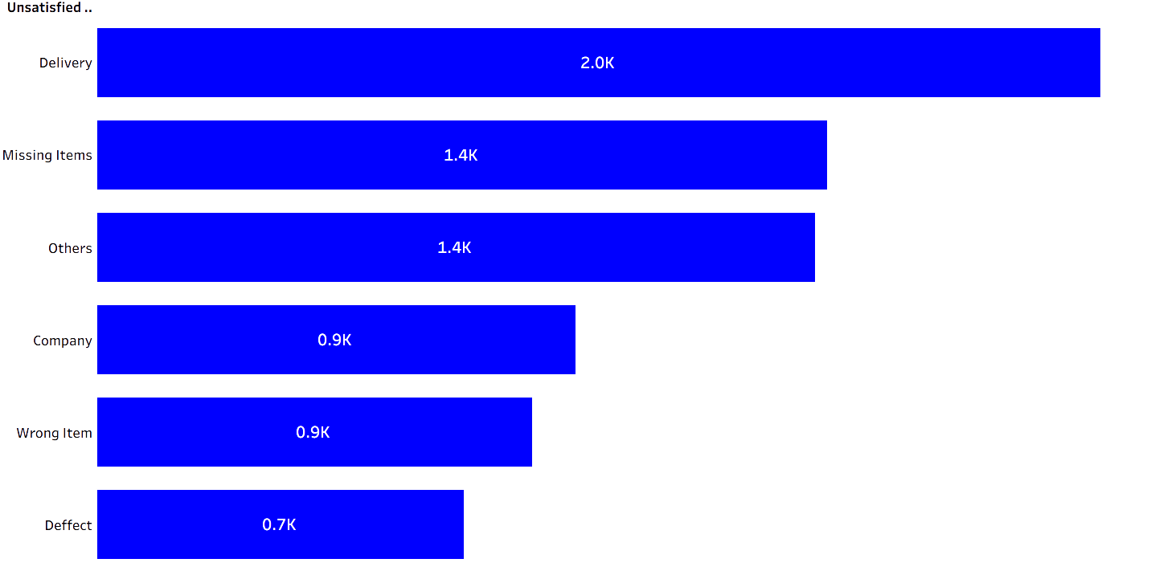
Sellers Per Comments Category
Platform
Carrier
Seller

Slide 24
Recommendations
Implement early-warning alerts
Introduce performance-based incentives
Increase verification and inspection

Slide 25

Time Limited
Missing Data
Limitations
2017 - 2018
Product Categorization
Languages Barrier
Lack of Details
Portuguese
Delivery Agent

Slide 26


Thank You

